Slide 1
Smart Home Lighting System Team 22

Slide 2
Overview
What did we do?
Demo
What are we going to do?

Slide 3
What did we do?
User Interface
Deployed project on Raspberry Pi
Established LED strip connection with PI

Slide 4
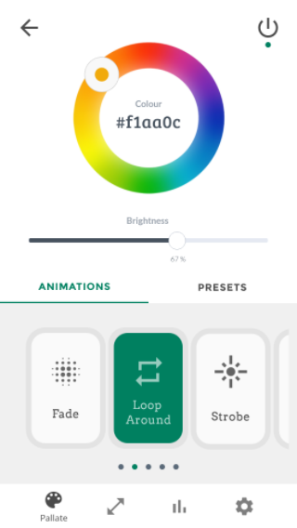
User Interface
Mobile app
User friendly
Responsive
Consistent
Intuitive
Place your screenshot here

Slide 5
DEMO

Slide 6
Project on Raspberry PI
Installed Tomcat server
Deployed project in IntelliJ
Run the project locally on Raspberry pi

Slide 7
LED STRIP

Slide 8
What are we going to do?
Establish data flow between LED strip and UI
To light up LED Strip with Java code
Integrating UI for user settings, ldr data, screen extension

Slide 9
Thanks!
Any questions?

